Slide 1
How has the sentiment of US presidential speeches about Climate change evolved in the last 20 years?
Luke Smith, Augusto Fonseca, Jorge Roa, Alvaro Guijarro

Slide 2

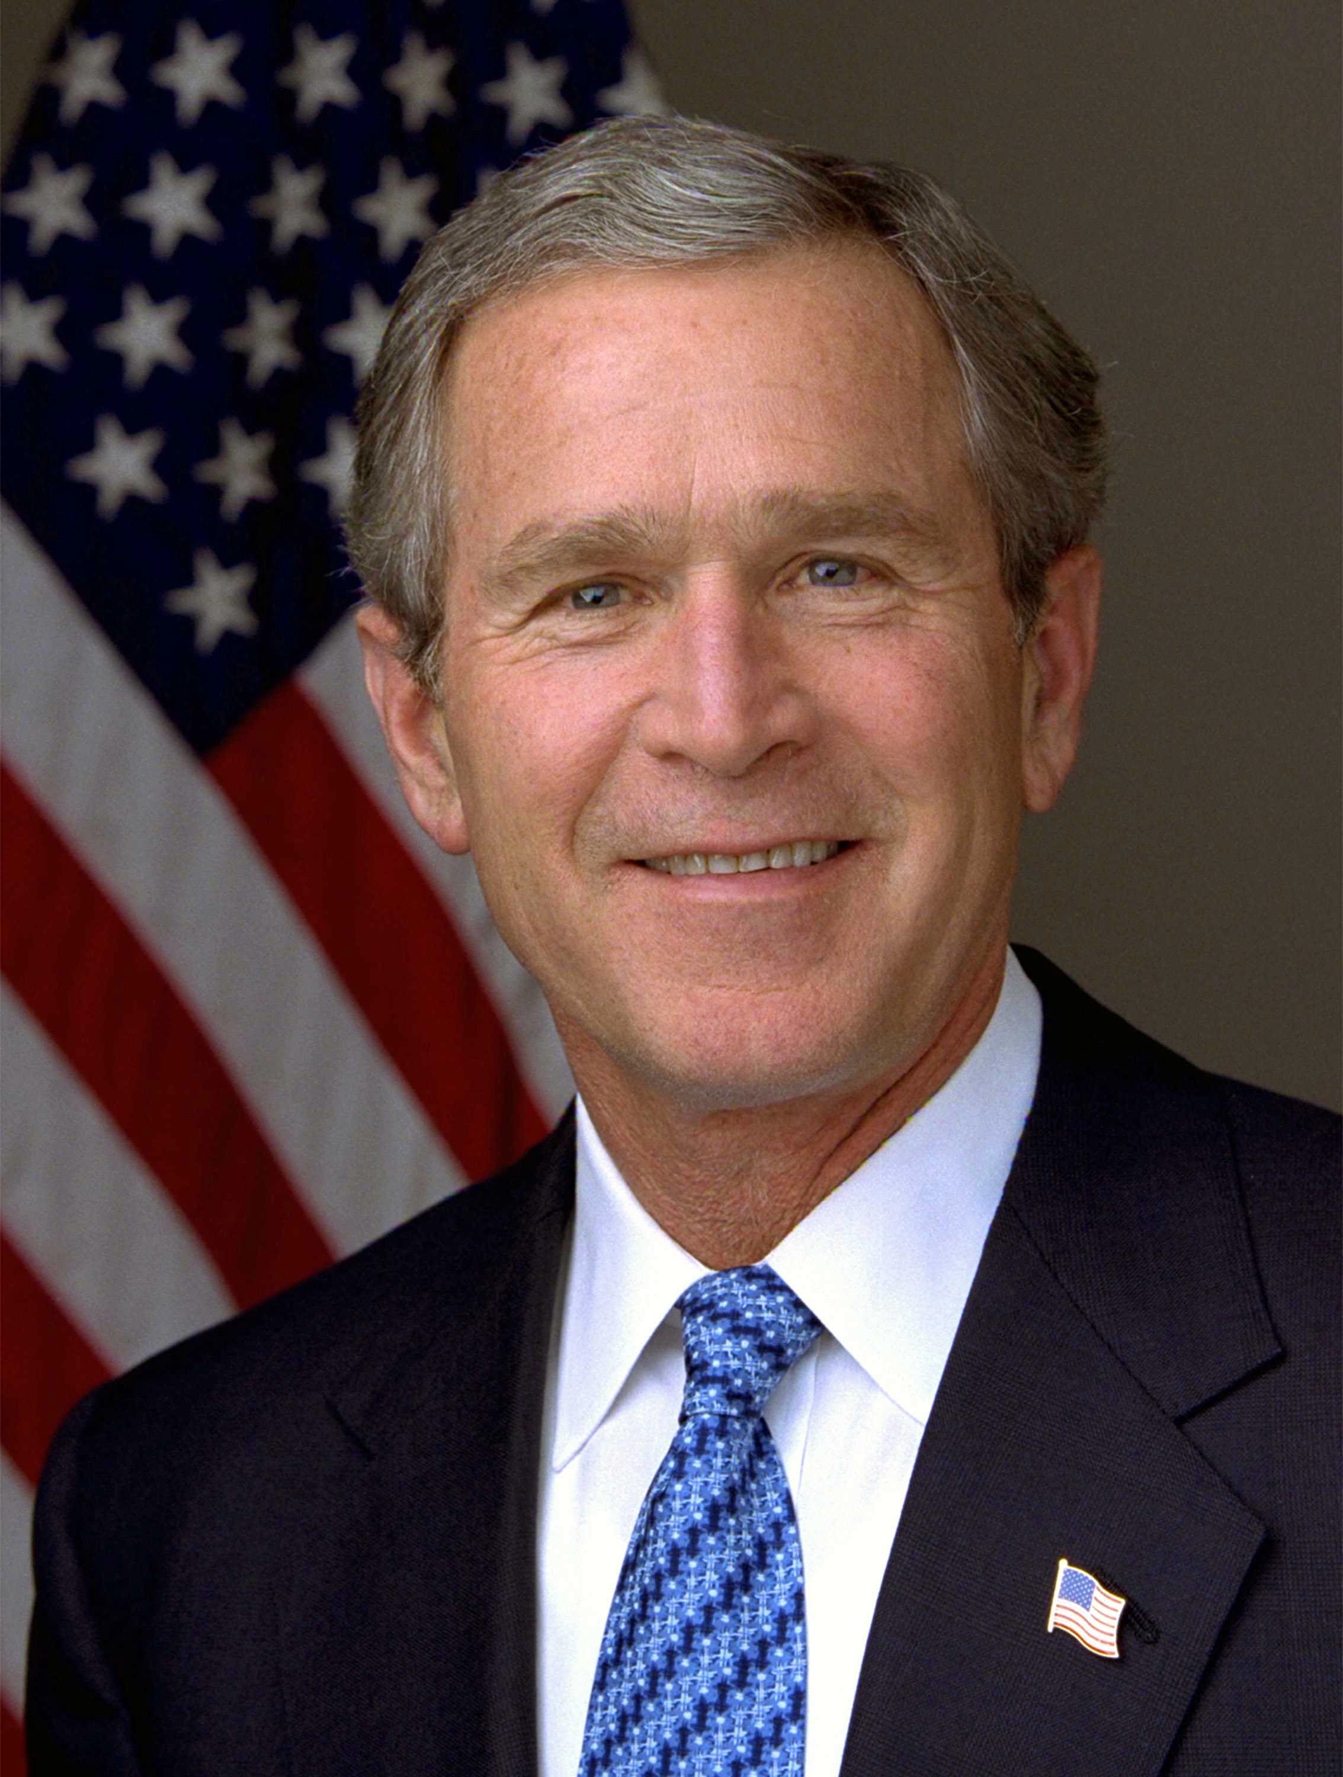
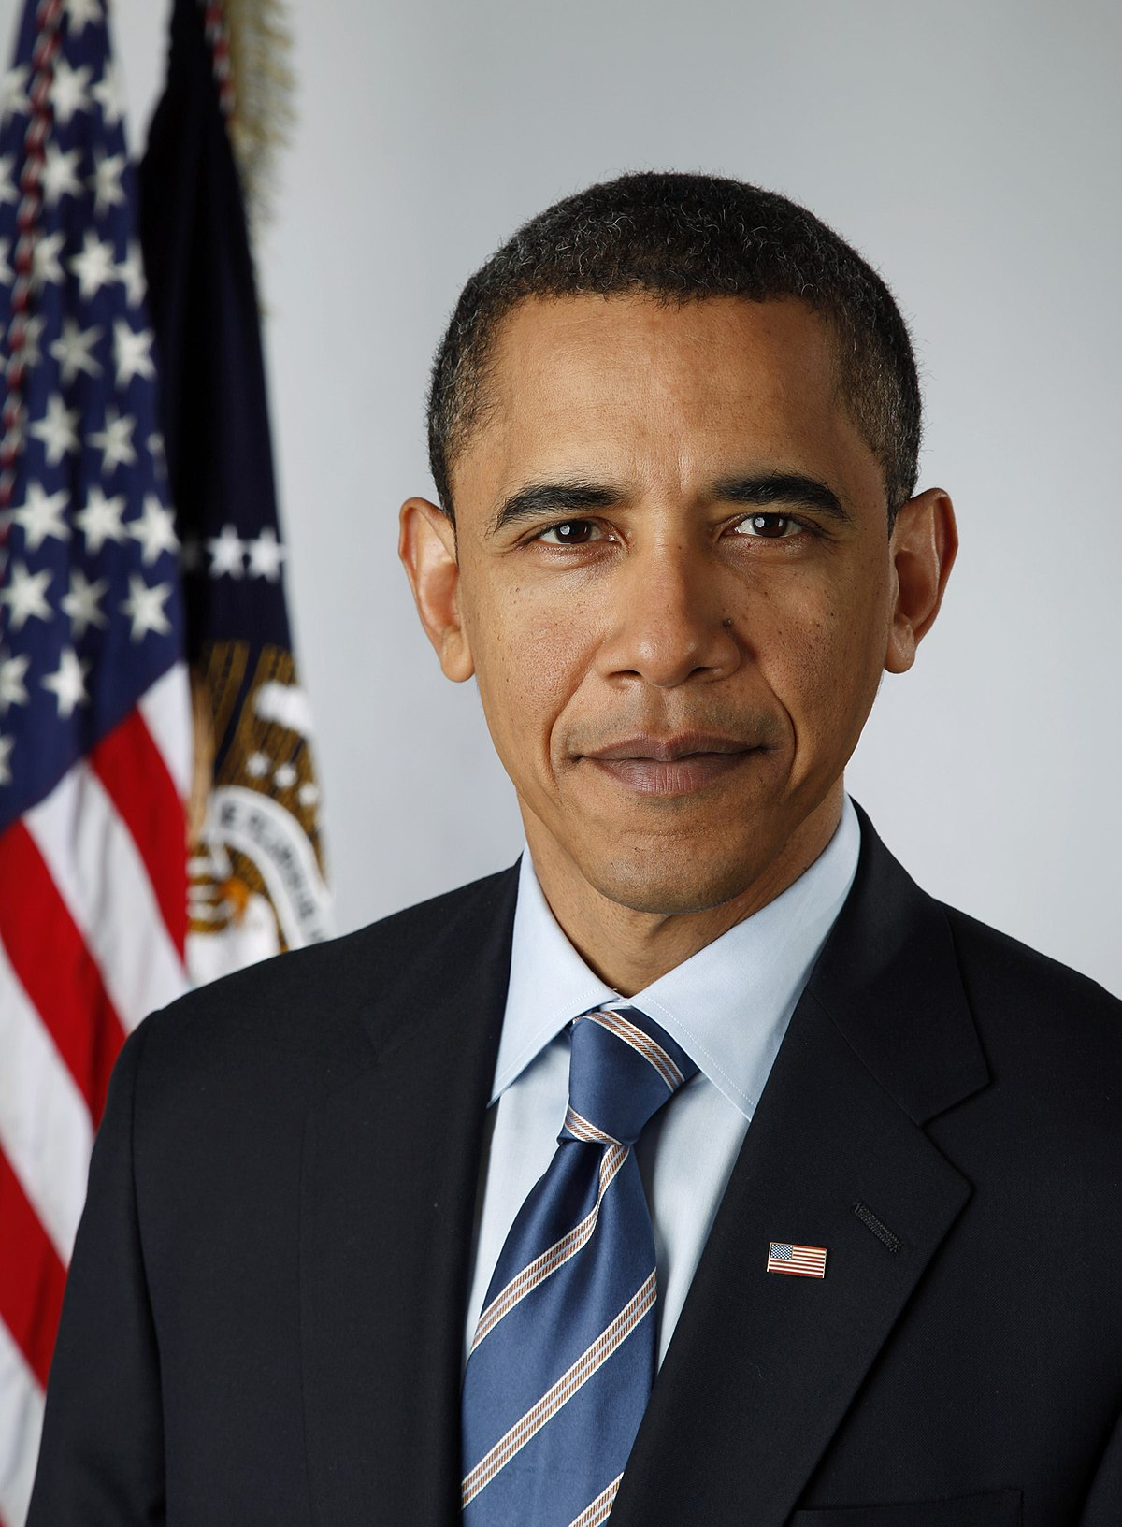

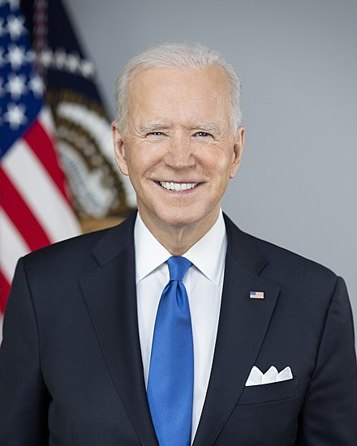
Has there been a change in narrative?

Slide 3
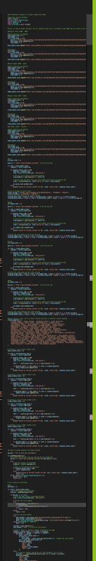
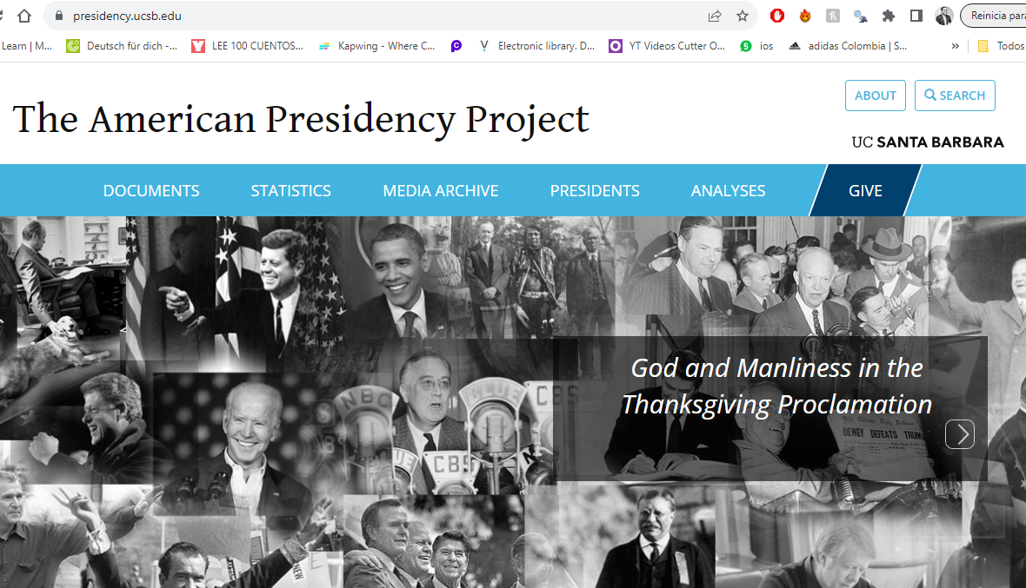
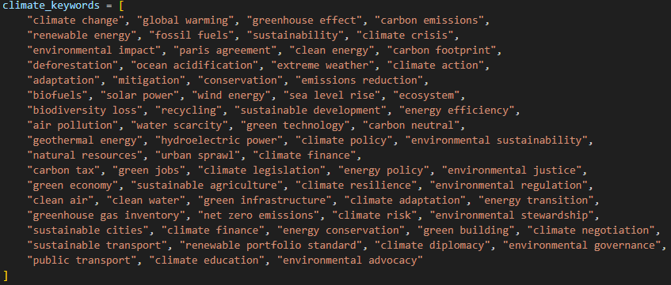
The Data – Web Scrapping
160,314 Presidential and Non-Presidential Records (Hosted in UC Santa Barbara)
Scraped all the speeches given by U.S Presidents since 2000 using Selenium & Beautiful Soup.
Identified climate related keywords to filter climate related speeches
Created a joint data base with Spoken Addresses, Remarks, and Statements.

Slide 4
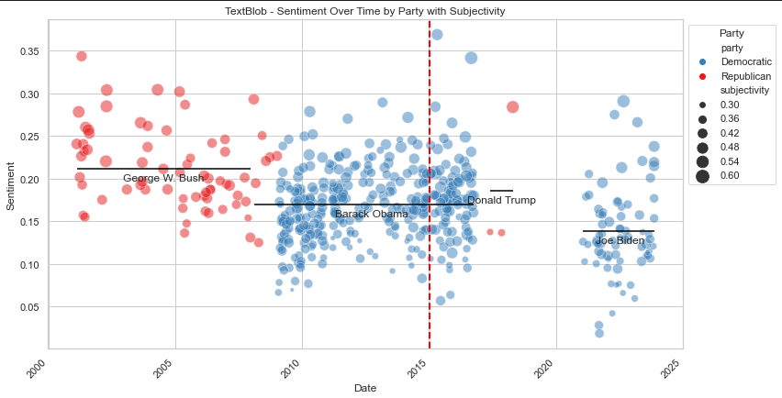
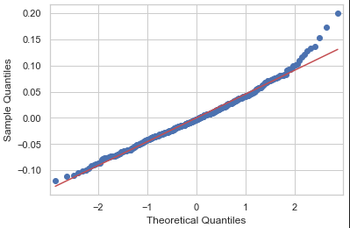
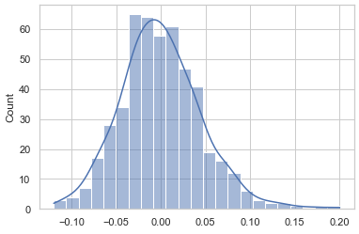
Analysis
President Obama was the most vocal about climate change, having address it at least 345 times during his 2 terms.
President | Speeches
George W. Bush | 72
Barack Obama | 345
Donald Trump * | 3
Joe Biden | 75
Second Finding: Data set is not balanced. Analyzed sentiment scores for each speaker.
Independence of Observations: Passed, Speeches are independent of each other.
Homogeneity of Variances: Passed, as Levene's test resulted in a p-value of 0.327, indicating no significant difference in variances between groups.
Normal Distribution of Residuals: Failed, as the Shapiro-Wilk test yielded a p-value of 5.138e-05, suggesting the residuals do not follow a normal distribution.
First Finding: President Trump relation with climate change topics. 74 Actions by the Trump administration to weaken environmental protection.
* This dataset doesn’t contain DT rallies

Slide 5
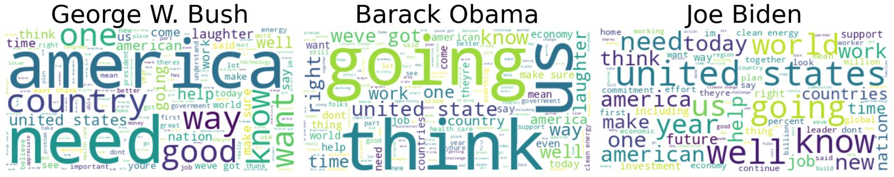
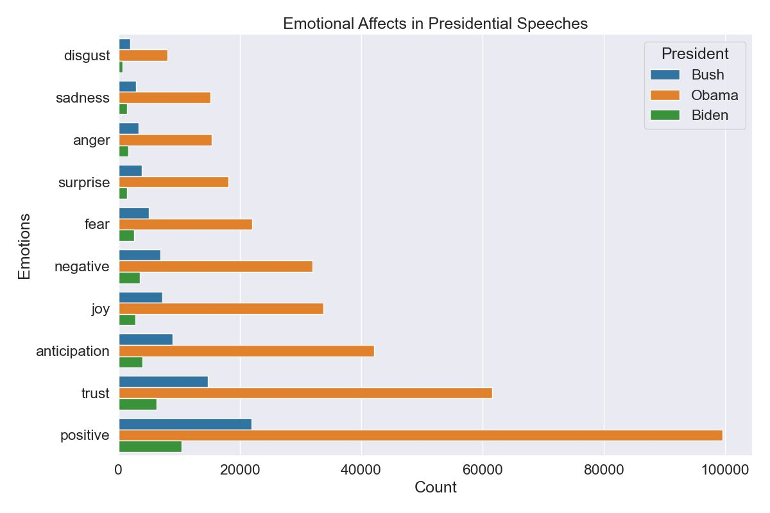
How are the presidents referring to climate change?
Third Finding: Positive, Trust, Anticipation, and Joy emotions were called up more in the speeches than Negative, Fear, Surprise, Anger, Sadness, Disgust.
Emotions were introduced in our analysis with NRCLex library, that will measure emotional affect from a body of text. Affect dictionary contains approximately 27,000 words, and is based on the National Research Council Canada (NRC) affect lexicon and the NLTK library's WordNet synonym sets.

Slide 6
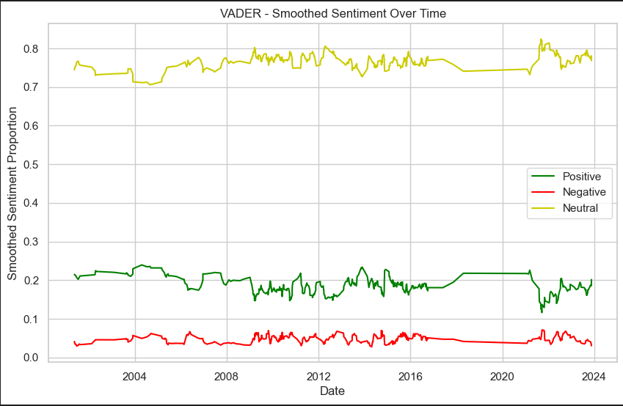
How are the presidents referring to climate change?
Fourth Finding: Positive sentiment has generally been dominant compared to negative sentiment, suggesting a more positive portrayal or discussion of climate change issues in the analyzed speeches.
The neutral sentiment line shows fewer fluctuations than the positive and negative, and proportionally this type of language is always used in over 70% of the speeches’ contents, indicating a consistent use of neutral language throughout the speeches.
This might suggest a measured approach to discussing climate change, potentially aiming to inform rather than evoke strong emotion.
The VADER sentiment analysis tool is specifically attuned to sentiments expressed in social media and similar texts. It is useful for capturing the emotional tone of texts, making it suited for analyzing speeches where emotional appeal is significant.

